Slide 1
System for Beginner
Speaker : Yi Jung Hun

Slide 2
Contents
What is Linux Stack?
Prepare this
Sample Code
Calling Convention
Overflow

Slide 3



What is Linux Stack? – Prepare this

Slide 4
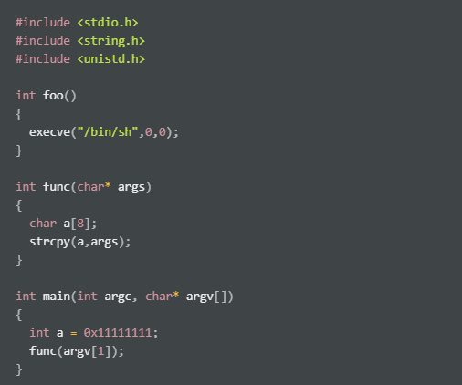
What is Linux Stack? – Sample code
gcc –o bof bof.c –fno-stack-protector

Slide 5
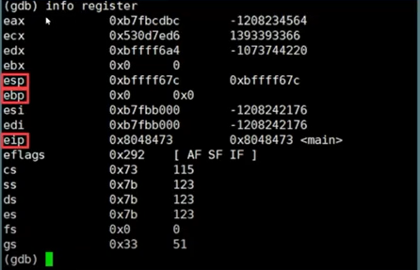
What is Linux Stack? – Sample code
X86 Register
SP : Stack Pointer
BP : Base Pointer
IP : Instruction Pointer

Slide 6

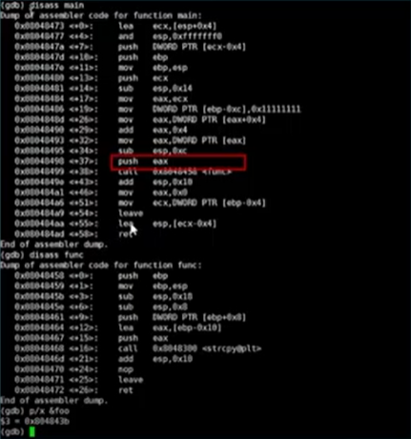
What is Linux Stack? – Calling convention
(Gdb) dissas main
Low address
…
%ESP
&argv[1]
0x11111111
…
Push EAX
Call <func>
%EBP
Main sfp
Main ret
High address

Slide 7
What is Linux Stack? – Calling convention
Low address
%ESP
Func ret
0x804849e
&argv[1]
0x11111111
Dissas func
…
%EBP
Main sfp
Main ret
High address

Slide 8
What is Linux Stack? – Calling convention
Low address
%ESP
…
Char a[ ]
Func sfp
%EBP
Func ret
0x804849e
&argv[1]
Dissas func
0x11111111
…
Main sfp
Main ret
High address

Slide 9
What is Linux Stack? – Calling convention
Low address
Argv[1]
Char a[ ]
Func sfp
%EIP
Func ret
0x804849e
%ESP
&argv[1]
0x11111111
Call <strcpy>
…
%EBP
Main sfp
Main ret
High address

Slide 10
Thank you

